Slide 1
Field-Effect Transistors
Become familiar with the construction and operating characteristics of Junction Field Effect (JFET), Metal-Oxide Semiconductor FET (MOSFET),
Be able to sketch the transfer characteristics from the drain characteristics of a JFET, MOSFET,
The BJT transistor is a current-controlled device as depicted in Fig. 6.1a ,
whereas the JFET transistor is a voltage-controlled device as shown in Fig. 6.1b .

Slide 2
Types of FET’s
JFET – Junction Field Effect Transistor
MOSFET – Metal Oxide Semiconductor Field Effect Transistor
D-MOSFET - Depletion Mode MOSFET
E- MOSFET - Enhancement Mode MOSFET

Slide 3
Construction of the n -channel JFET
There are two types of JFET’s: n-channel and p-channel. The n-channel is more widely used.
There are three terminals: Drain (D) and Source (S) are connected to n-channel Gate (G) is connected to the p-type material

Slide 4
JFET Operating Characteristics
VGS = 0 V, VDS -Some Positive Value
The instant the voltage VDD (= VDS) is applied, the electrons are drawn to the drain terminal, establishing the conventional current I_{D} with the defined direction of Fig. 6.5 .
The path of charge flow clearly reveals that the drain and source currents are equivalent (I_{D} = I_{S}). Under the condition
In Fig. 6.5 , the flow of charge is relatively uninhibited and is limited solely by the resistance of the n -channel between drain and source.

Slide 5
JFET Operating Characteristics
VGS = 0 V, VDS -Some Positive Value
It is important to note that the depletion region is wider near the top of both p –type materials.
Assuming a uniform resistance in the n -channel, we can break down the resistance of the channel into the divisions appearing in Fig. 6.6
The result is that the upper region of the p -type material will be reverse-biased by about 1.5 V, with the lower region only reverse-biased by 0.5 V.
Recall from the discussion of the diode operation that the greater the applied reverse bias, the wider is the depletion region
The fact that IG = 0 A is an important characteristic of the JFET.

Slide 6
JFET Operating Characteristics
VGS = 0 V, VDS Some Positive Value
As the voltage V DS is increased from 0 V to a few volts, the current will increase as determined by Ohm’s law and the plot of I D versus V DS will appear as shown in Fig. 6.7.
The more horizontal the curve, the higher the resistance, suggesting that the resistance is approaching “infinite” ohms in the horizontal region.
If V_{DS} is increased to a level where it appears that the two depletion regions would“touch” as shown in Fig. 6.8 , a condition referred to as pinch-off will result. The level of V_{DS} that establishes this condition is referred to as the pinch-off voltage and is denoted by V_{P} , as shown in Fig. 6.7 .

Slide 7
JFET Operating Characteristics
VGS = 0 V, VDS Some Positive Value
As V_{DS} is increased beyond V_{P} , the region of close encounter between the two depletion regions increases in length along the channel, but the level of I_{D} remains essentially the same.
In essence, therefore, once V_{DS} > V_{P} the JFET has the characteristics of a current source.
As shown in Fig. 6.9 , the current is fixed at I_{D} = I_{DSS}, but the voltage V_{DS} (for levels > V_{P} ) is determined by the applied load.
The choice of notation I_{DSS} is derived from the fact that it is the drain-to- source current with a short-circuit connection from gate to source.
I_{DSS} is the maximum drain current for a JFET and is defined by the conditions V_{GS} = 0 V and V_{DS} > |V_{P}| .

Slide 8
JFET Operating Characteristics
V GS < 0 V
The voltage from gate to source, denoted V_{GS} , is the controlling voltage of the JFET.
Just as various curves for I_{C} versus V_{CE} were established for different levels of I_{B} for the BJT transistor, curves of I_{D} versus V_{DS} for various levels of V_{GS} can be developed for the JFET

Slide 9
JFET Operating Characteristics:
p -Channel Devices
For the p -channel device, the channel will be constricted by increasing positive voltages from gate to source and the double-subscript notation for V_{DS} will result in negative voltages for V_{DS} on the characteristics of Fig. 6.13 , which has an I_{DSS} of 6 mA and a pinch off voltage of V_{GS} = +6 V.
The region to the right of the pinch-off locus of Fig. 6.11 is the region typically employed in linear amplifiers

Slide 10
JFET – Symbols

Slide 11
JFET Operating Characteristics
There are three basic operating conditions for a JFET:
JFET’s operate in the depletion mode only
VGS = 0, VDS is a minimum value depending on IDSS and the drain and source resistance
VGS < 0, VDS at some positive value and
Device is operating as a Voltage-Controlled Resistor
For an n channel JFET, VGS may never be positive*
For an p channel JFET, VGS may never be negative*

Slide 13
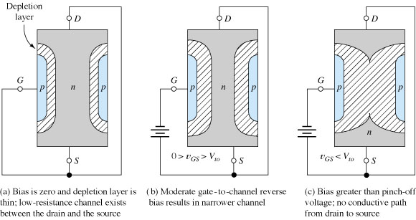
N-Channel JFET Operation
The nonconductive depletion region becomes thicker with increased reverse bias.
(Note: The two gate regions of each FET are connected to each other.)

Slide 14
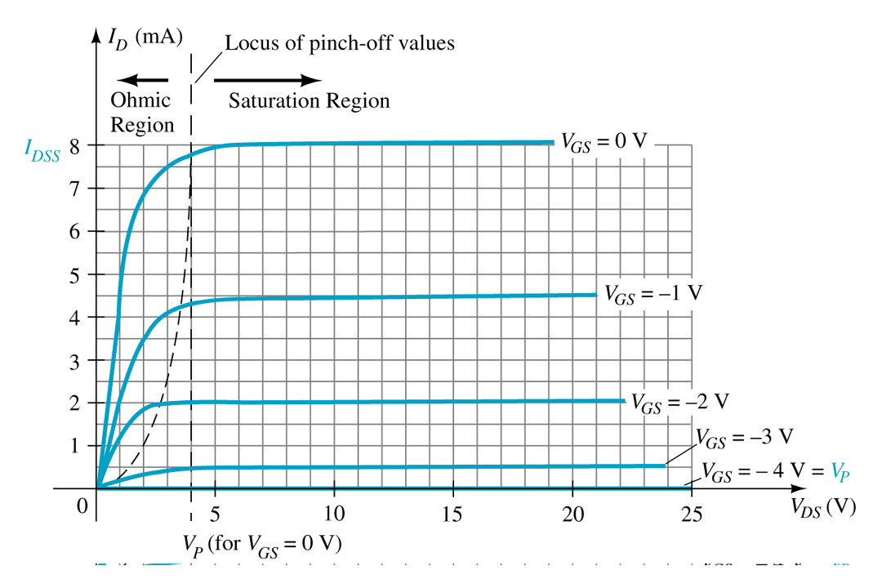
ID ≤ IDSS
As V_{GS} becomes more negative:
• the JFET will pinch-off at a lower voltage (Vp).
• I_{D} decreases (I_{D} < I_{DSS}) even though V_{DS} is increased.
• Eventually I_{D} will reach 0A. V_{GS} at this point is called Vp or V_{GS(off)}.
• Also note that at high levels of V_{DS} the JFET reaches a breakdown situation. ID will increases uncontrollably if V_{DS} > V_{DSmax}.

Slide 15
Symbols
VGS = 0 V, ID = IDSS ;
cutoff (ID = 0 A) VGS less than the pinch-off level;
ID is between 0 A and IDSS for VGS 0 V and greater than the pinch-off level.

Slide 16
TRANSFER CHARACTERISTICS

Slide 17
TRANSFER CHARACTERISTICS
Applying Shockley’s Equation

Slide 18
TRANSFER CHARACTERISTICS
It should be obvious from the above that given I_{DSS} and V_{P} (as is normally provided on specification sheets), the level of I_{D} can be found for any level of V_{GS} .
Conversely, by using basic algebra we can obtain [from Eq. (6.3)] an equation for the resulting level of V_{GS} for a given level of I_{D}. The derivation is quite straightforward and results in

Slide 19
TRANSFER CHARACTERISTICS
Shorthand Method

Slide 22
IMPORTANT RELATIONSHIPS

